Slide 1
Wireless Body Area Networks
Pratishtha Verma (A20357099)
Based on Wireless Body Area Networks: A Survey
Samaneh Movassaghi, Mehran Abolhasan, Justin Lipman, David Smith, Abbas Jamalipour

Slide 2
Introduction
World Population Growth is facing 3 major challenges
Demographic Peak of Baby Boomers
Average Increase in Life Expectancy from 69.8 years to 78.2 years till 2010
Huge Rise in Health Care Costs
Probable Outcomes
Overload to existing health care systems
Health Care Expenditure will be 20% of the GDP, big threat to US Economy

Slide 3
United States Age Pyramid

Slide 4
Today’s Healthcare Scenario
Millions of people die from Cancer, Parkinson’s, Asthma, Obesity, Cardiovascular diseases etc.
Diagnosis is late, leads to further complications
Probable Solution:
Proactive wellness management
Focus on early detection & management of disease
c) Usage of Wearable health monitoring systems

Slide 5
What are WBANs?
“Network consisting of intelligent, low-power, Micro & Nano-technology sensors and actuators, which can be placed on the body, or implanted in the human body (even blood stream), thereby providing timely data.”
International Standards Specifications (IEEE 802.15.6):
Low Power
Short Range
Extremely Reliable
Supports wide range of data rates from 75.9 Kbps to 15.6 Mbps

Slide 6
Quick Advantages
Capable of transforming people’s interaction & benefit from Information Technology
Capable of sampling , monitoring , processing & communicating various vital signs & providing real time feedback to the user, medical personnel without causing any discomfort to patient
Continuous monitoring of physiological parameters, providing greater flexibility & mobility to patients
Doctors get a clearer view of patient’s real time health scenario due to large intervals data
If abnormality is detected, data collected by sensors can be sent to gateway(e.g. cellphone) & via Internet/Cellular Network delivered to doctor/ emergency center where action can be taken

Slide 7
Interoperation
Some of technologies are:
ZigBee, Bluetooth
Wireless Sensor Networks, Wireless Personal Area Networks
Video Surveillance Systems
Cellular Networks
Advantages
Marketing Opportunities for services, advanced computer electronics will increase
Autonomous & Intelligent applications will improve one’s quality of life

Slide 8
APPLICATIONS

Slide 9
WEARABLE WBANs

Slide 10
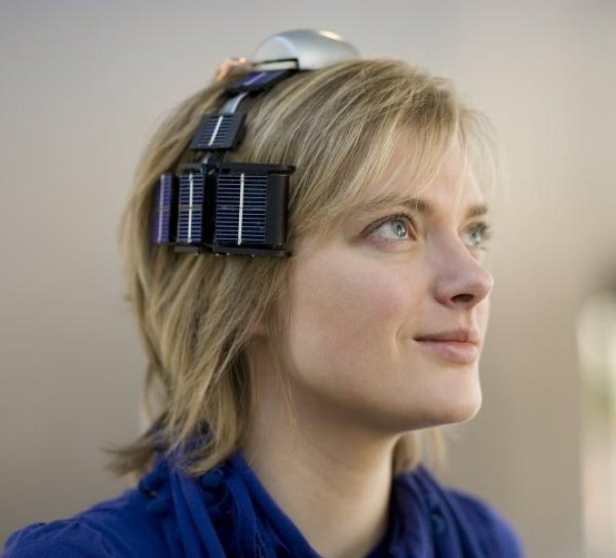

Slide 11
Sleep Staging
Sleeping Disorders Facts
Sleep constitutes 1/3rd of our everyday life. Highly Important physiological function!
27% of World’s Population affected by the disorder
18 billion $ loss reported till now in production at work
Consequences
Sleepiness at Work Place
Drowsy Driving
Cardiovascular Diseases

Slide 12
Handling Sleep Staging
POLYSOMNOGRAPHY
Analysis of bio potentials in a sleep laboratory overnight
Cables run from the patient’s head to a box connected to patient’s belt
Mechanism interrupts the patient from falling asleep
Disturbs patients motion & initiates noise thereby reducing signal quality
CHANGES
Delocalization of intelligence & instruments in their sensor nodes & cable removal

Slide 13
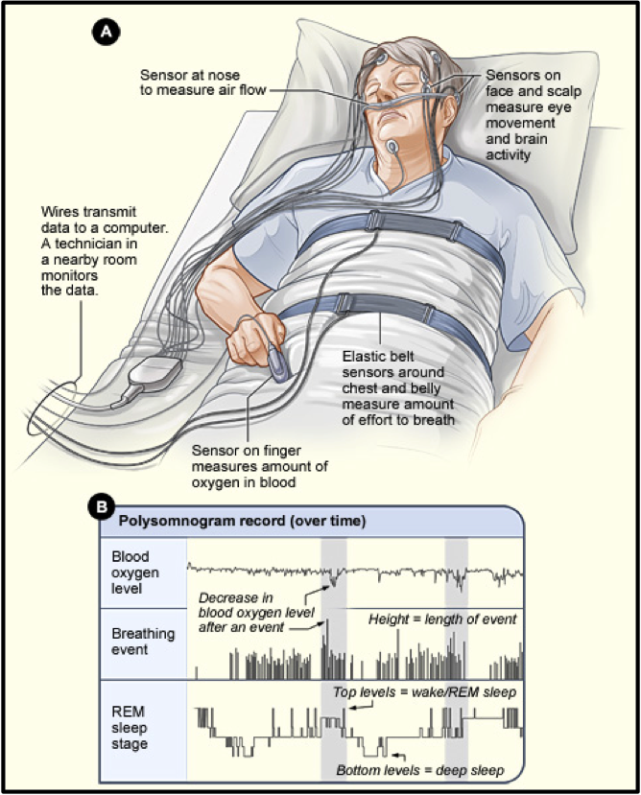

Slide 14
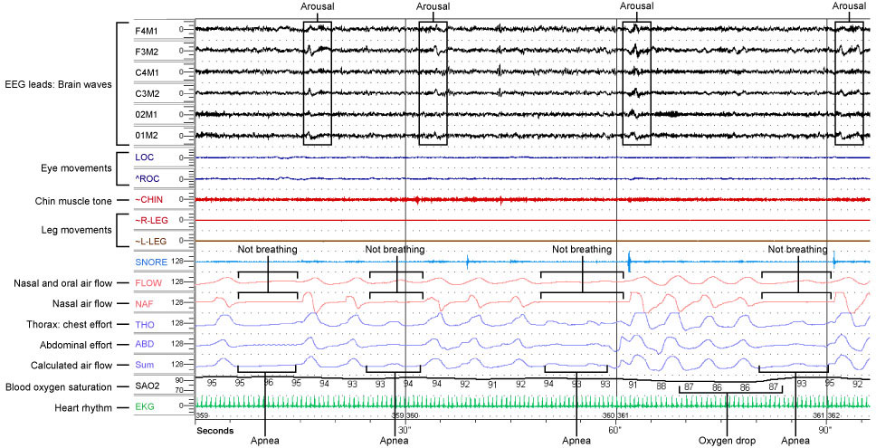

Slide 15
IMPLANT WBAN

Slide 16
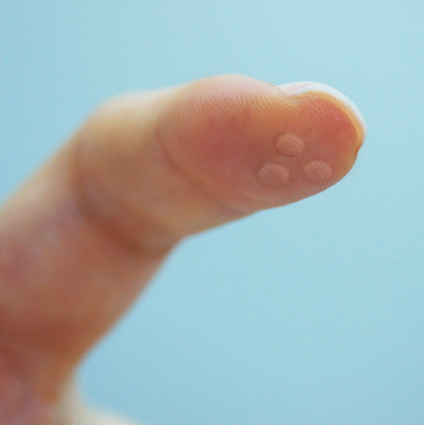

Slide 17
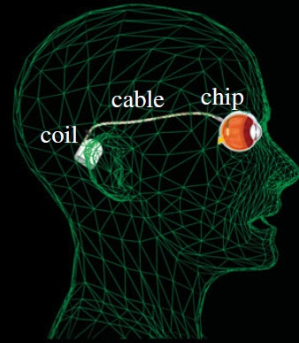

Slide 18
Patient Monitoring
Senses & Wirelessly transmits the vital body measurements such as heart rate, body temperature, respiration rate, blood pressure etc.
Capable of drug administration in hospitals, remote monitoring of human physiological data, aid rehabilitation of patients.
WBANs provide interconnection amongst various devices such as hearing aids, digital spectacles etc.
Also help in post treatment follow up, pharmaceutical research, trauma care etc.

Slide 19
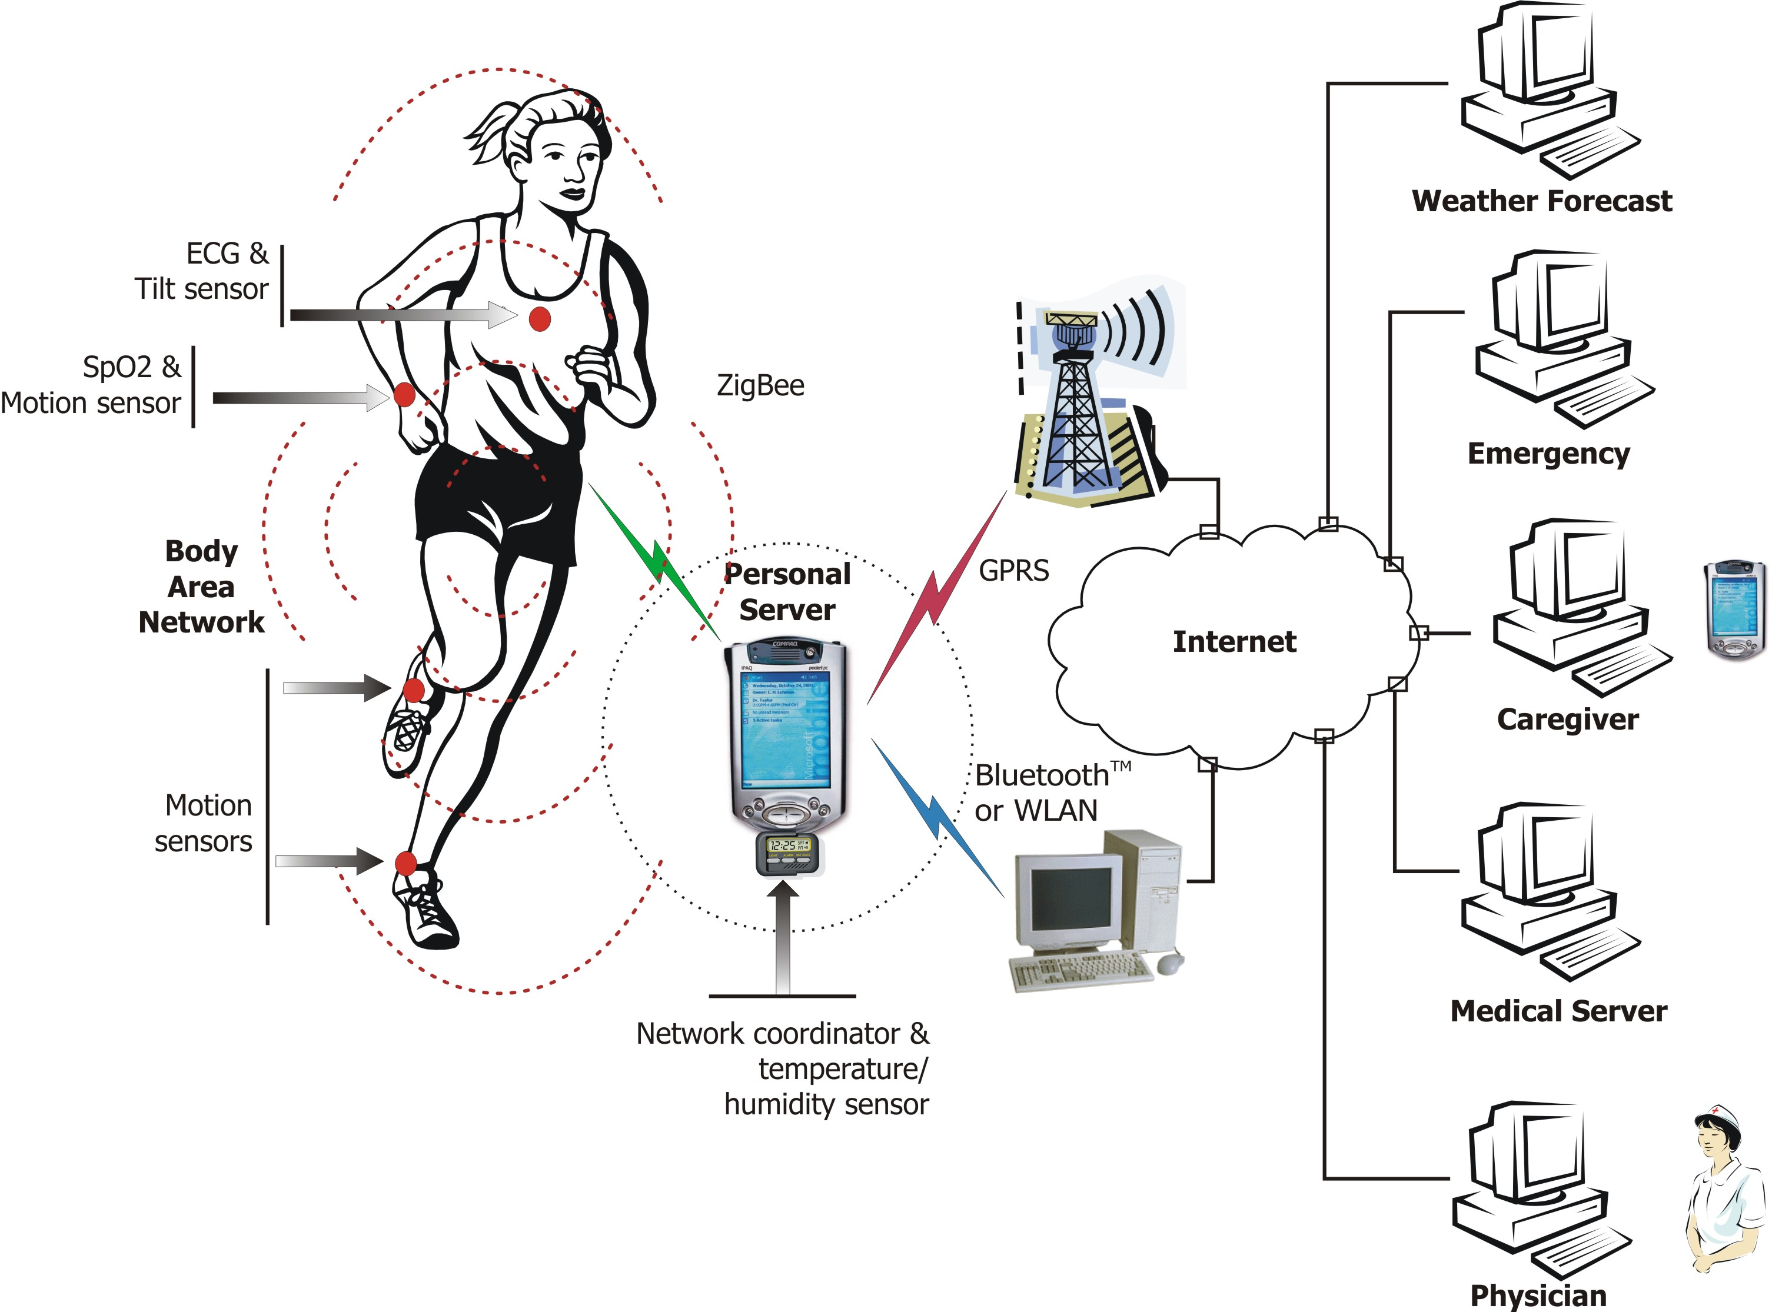
Health Monitoring

Slide 20
COMMUNICATION
ARCHITECTURE

Slide 22
Tier1: Intra WBAN
Depicts Network Interaction of nodes & there transmission ranges (~2 meters) in & around the human body.
Variable sensors forward body signals to a Personal Server.
Processed physiological data is then transmitted to an access point in Tier two.

Slide 23
Tier 2: Inter WBAN
INFRASTRUCTURE BASED ARCHITECTURE
Facilitates dynamic deployment in limited spaces like hospitals, etc.
AP acts as a database server related to it’s application
AD-HOC BASED ARCHITECTURE
Multiple APs transmit information among hospitals
Coverage Area is between 2 to 100 meters, for both long & short term setups
Mesh construction allows greater flexibility, wider radio coverage & supports patient mobility

Slide 24
Inter WBAN: Infrastructure Based Mode

Slide 25
Inter WBAN: AD-HOC Based Mode

Slide 26
Tier 3: Beyond WBAN
PDA bridges gap between Tier 2 & Tier 3
Design is application specific i.e. For medical applications, medical history & user profile is very important
Doctors/patients can be notified via Internet or SMS thereby restoring entire patient data for future medical treatment
PS in Tier 1 can either use GPRS/3G/4G instead of talking to an AP., depending on application

Slide 27
Conclusion
WBANs will allow for continuous monitoring of patients in medical applications, capable of early detection of abnormal conditions resulting in major improvements in the quality of life.
Basic vital signs monitoring (e.g. heart rate) can enable patients to engage in normal activities as opposed to being home bound or nearby specialized medical services.
Procedural research on this valuable technology has significant importance in better usage of available resources that will no doubt truly affect our future well being.

Slide 28
Thank You!!!

